Slide 1
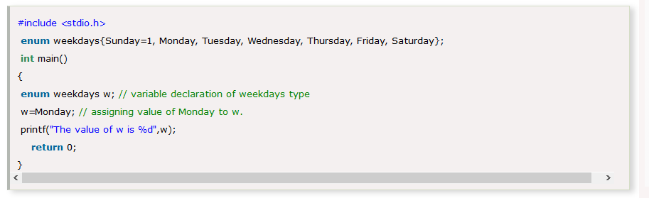
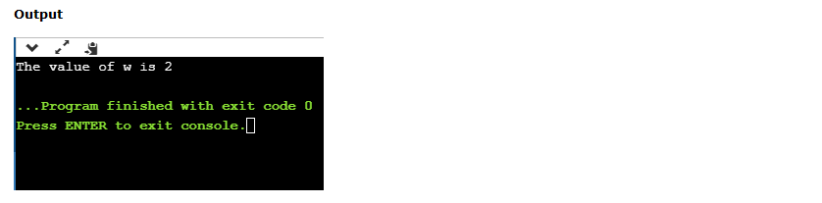

Example: 1.

Slide 2
Enumeration (or enum) in C.

Slide 3
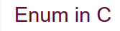
The enum is also known as the enumerated type.
It is a user defined data type.
It consists of integer values and it provides meaningful names to these values.
The use of enum in C, makes the program easy to understand and maintain.
The following is the syntax of enum:
enum flag{ const1,const2….constN};
The enum is named as flag containing ‘N’ integer constants. The default value of const1 is 0, const2 is 1 and so on.

Slide 4
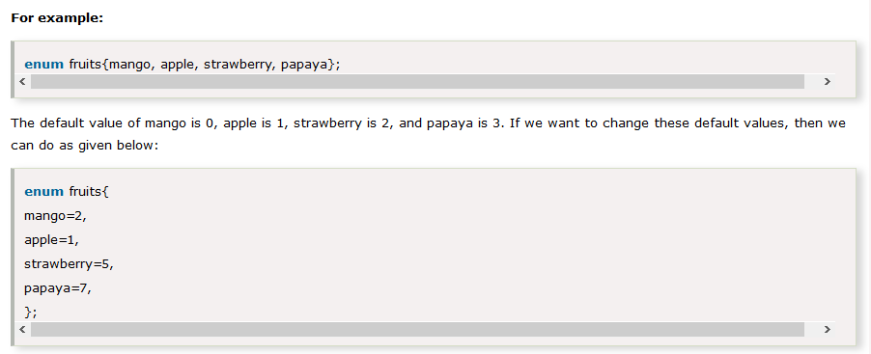

Slide 5
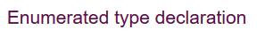
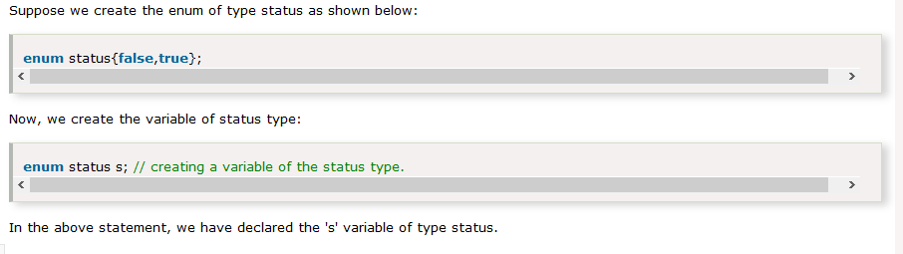
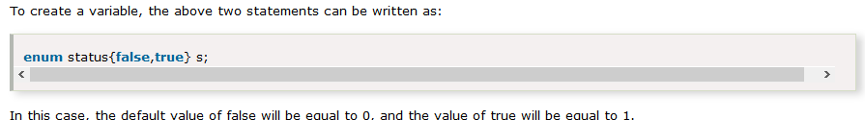

Slide 6
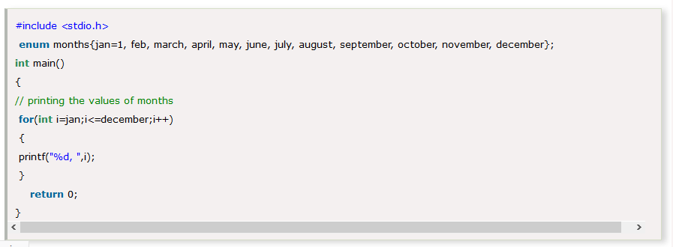
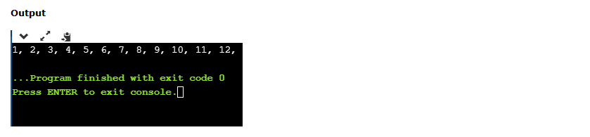
Example: 2.

Slide 7
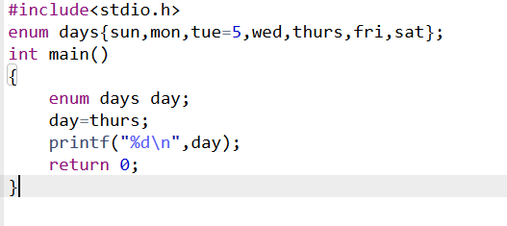
Example:3.
Output
7
The default value of ‘sun’ is 0 and mon is 1.
The value of tue is given as 5.
So the values of ‘wed’, ‘thurs’, ‘fri’ and ‘sat’ will become 6,7,8 and 9.
Thus the value of ‘thurs’ will be printed as 7.

Slide 8
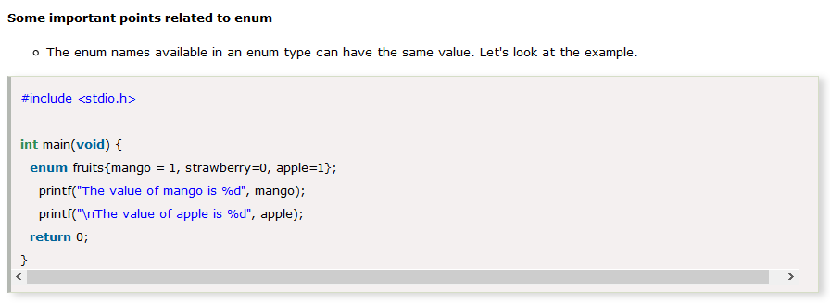
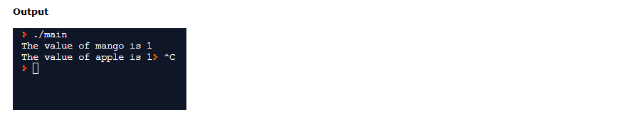

Slide 9
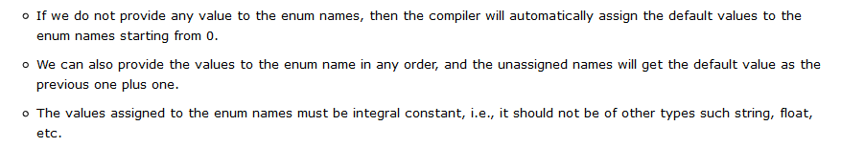

Slide 10
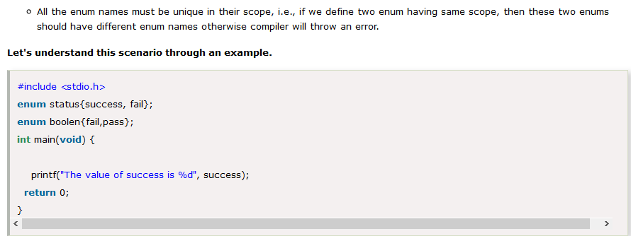
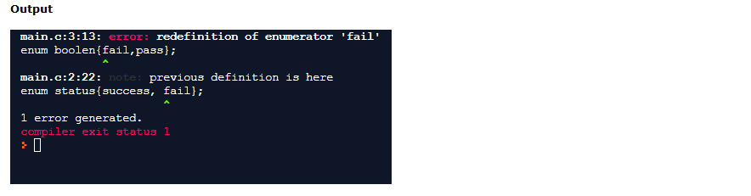

Slide 11
Thank You

